Slide 1

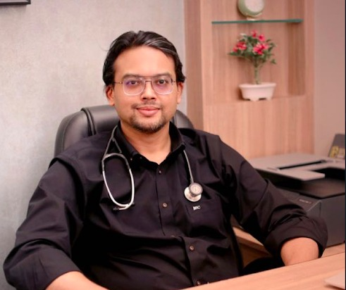
HEALTH LIVE @ SENIORSTODAY
DR ANKUR PHATARPEKAR

Slide 2

Season 2
Part2
Thursday, 12th May, 5:30 PM
Register here - https://bit.ly/st_gd02

Slide 3


Part 2
Wednesday, 18th May, 4:30 PM
Register
https://bit.ly/st_soh03

Slide 4

Good company to cultivate
good qualities.
साखी - कबिर संगति साधु की, ज्यों गन्धी का बास।
जो कुछ गन्धी दे नहीं, तो भी बास सुबास ।।
Tuesday, 17th May , 5pm
Register in advance for this meeting: https://bit.ly/st_uk03

Slide 5

Good company to cultivate
good qualities.
साखी - कबिर संगति साधु की, ज्यों गन्धी का बास।
जो कुछ गन्धी दे नहीं, तो भी बास सुबास ।।
Tuesday, 17th May , 5pm
Register in advance for this meeting: https://bit.ly/st_uk03

Slide 6
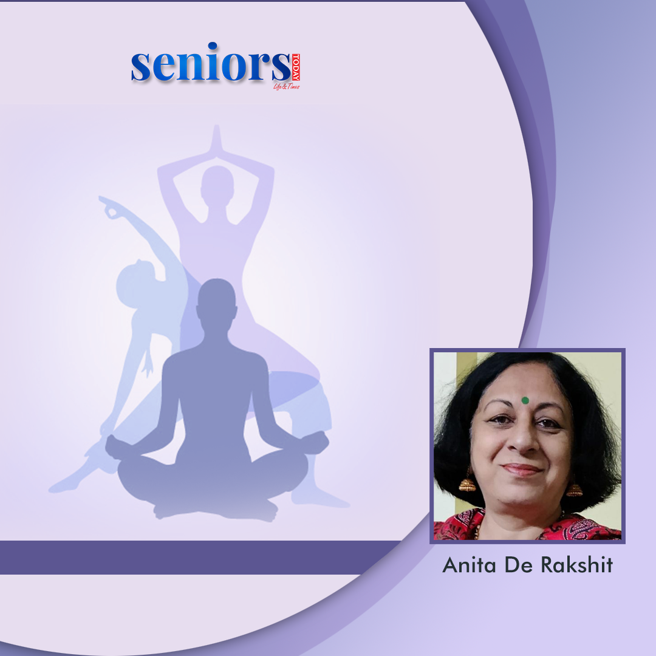
Easy Yoga for
Senior Citizens
Friday, 27th May, 5:30 PM
Register
https://bit.ly/st_ar01

