Slide 1
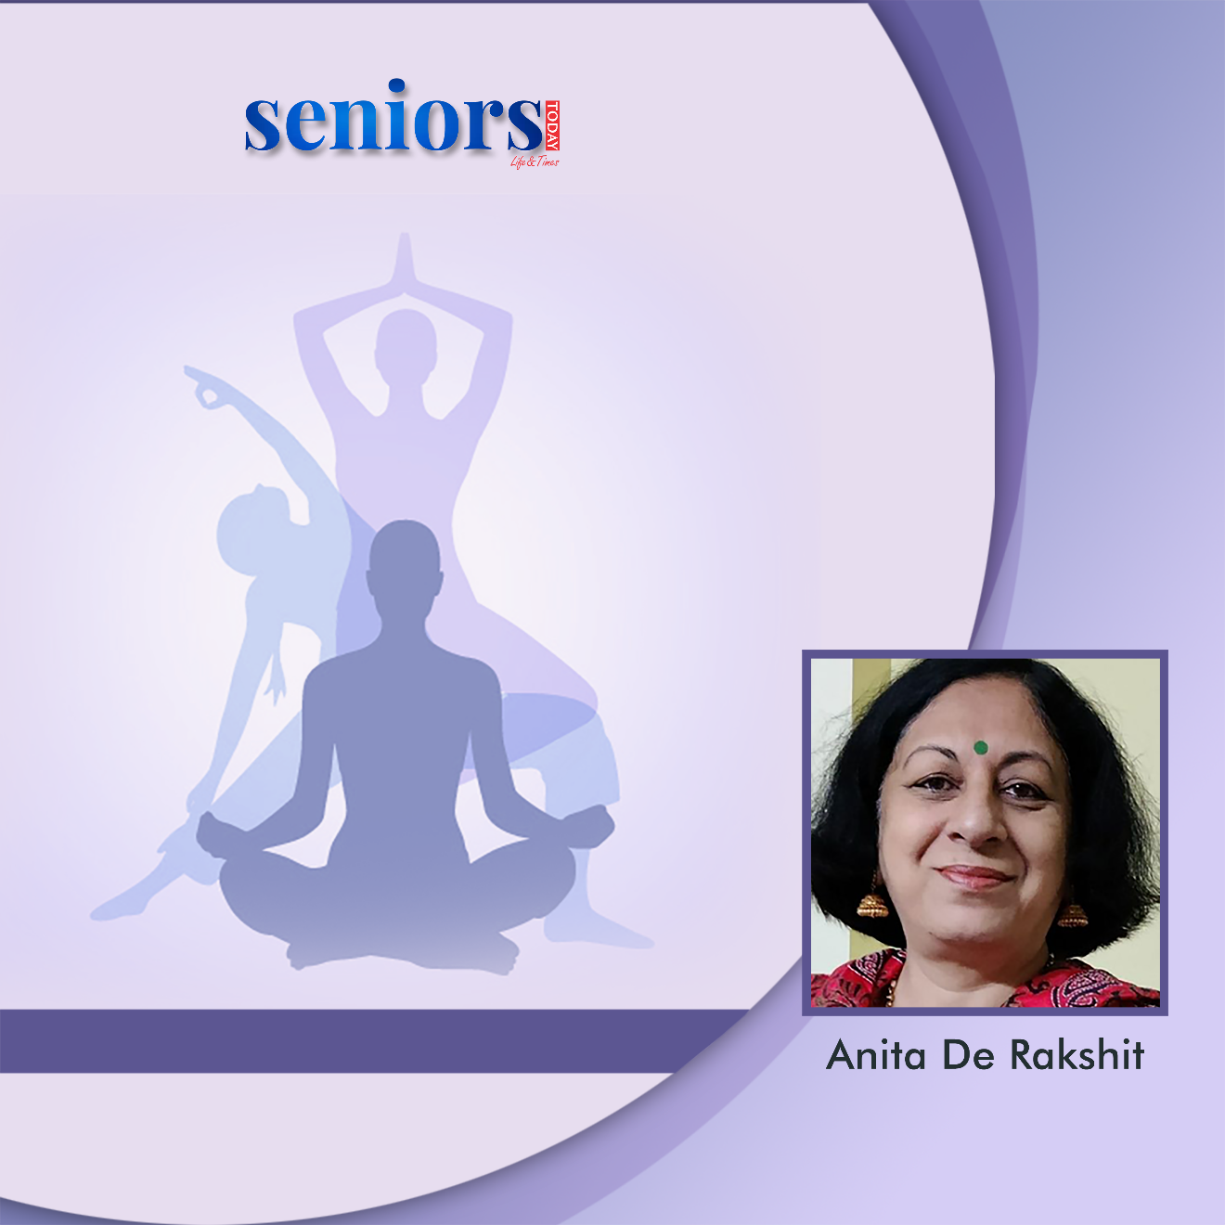
Rejoice Life with a Smile
Friday, 28th October, 11:00 AM
Register
https://bit.ly/st-yoga

Slide 2
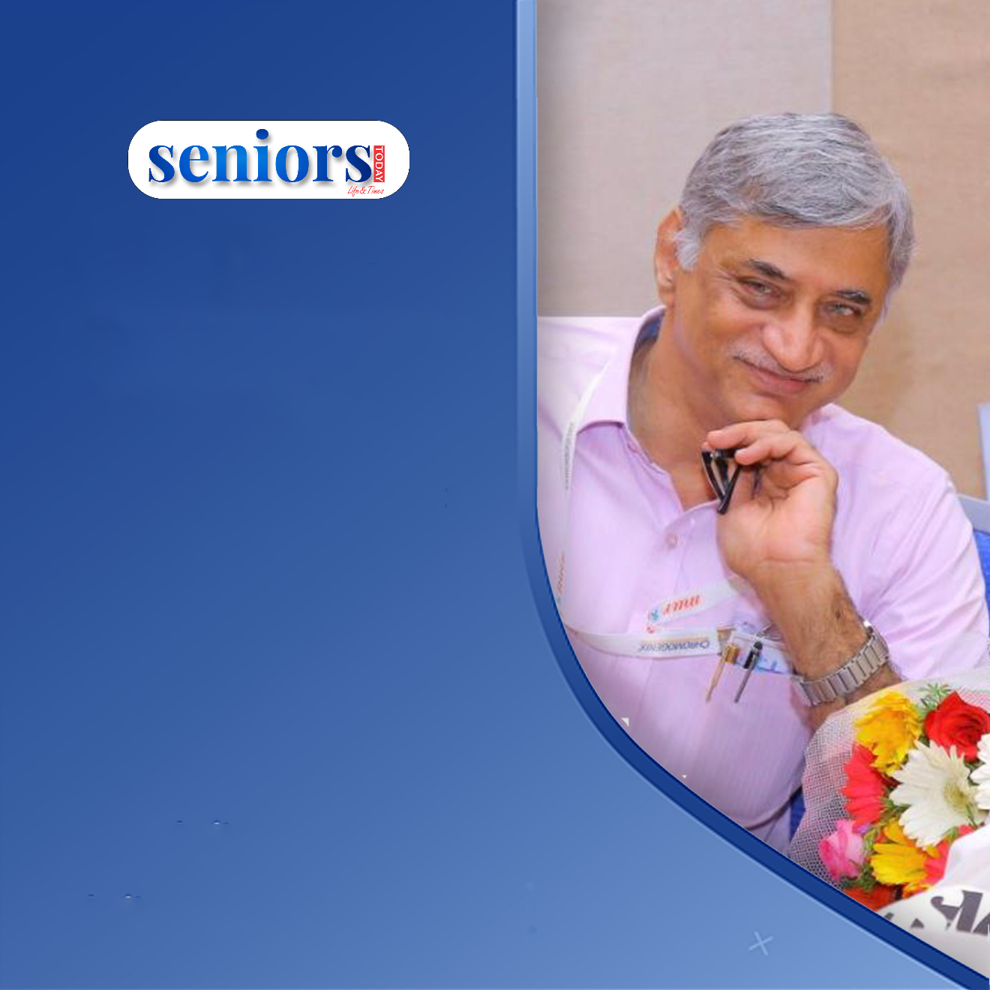
Seniors
Open House
with
Mohan Krishnan
Wednesday, 22nd June, 5:00 PM
Register
https://bit.ly/st_soh

Slide 3

Friday, 27th Oct, 2022 4:00 PM
Register - https://bit.ly/st-antaksharigame

Slide 4
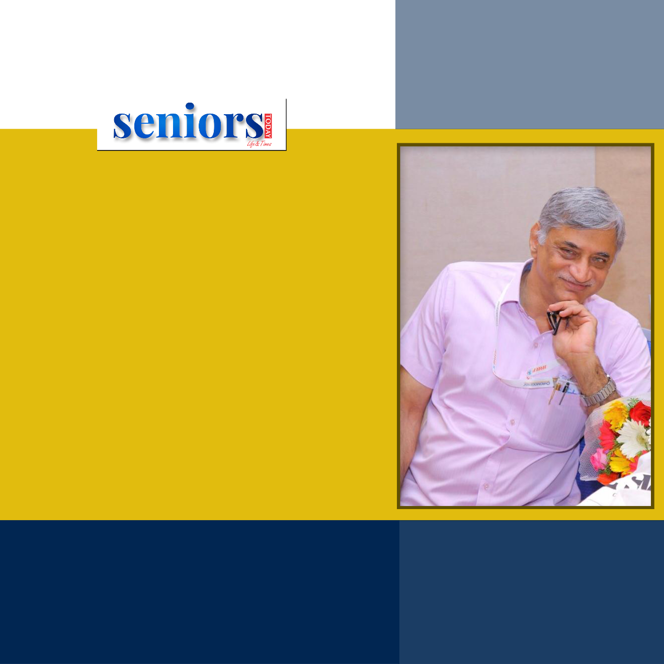
Popular songs
but singers forgotten
by Mohan Krishnan
Wednesday, 22nd June, 5:00 PM
Register
https://bit.ly/st_soh

Slide 5
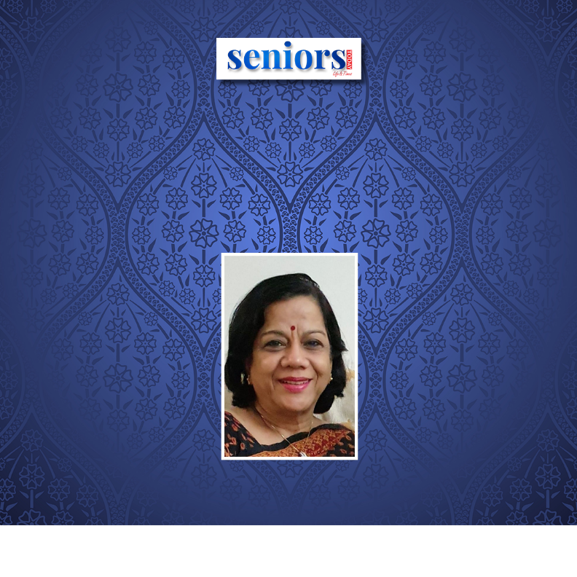
POETRY OF MAHADEVI VERMA JI
by Dr Sajni Vaidya
Friday, 28th October, 5:00 PM
Register - https://bit.ly/st-poetrysajni

Slide 6

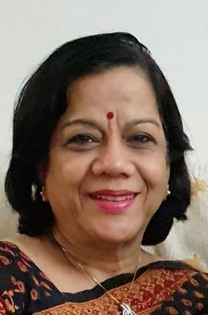
POETRY & PROSE
by Dr Sajni Vaidya
Wednesday, 22nd June, 5:00 PM
Register - https://bit.ly/st_soh

Slide 7
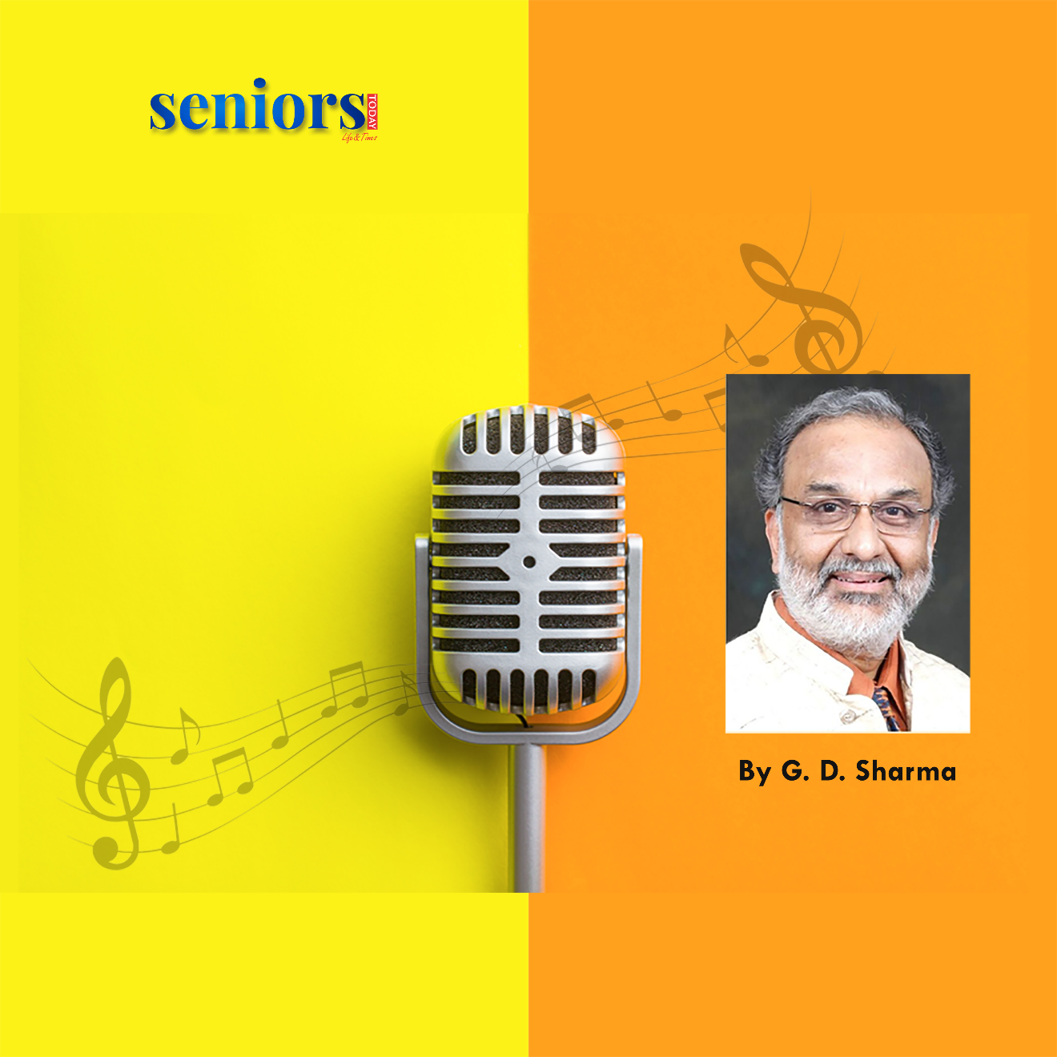
On Popular Demand
we bring to you
The A to Z
of Karaoke
Singing
Season 3
Thursday, 3rd Nov, 5:30 PM
Register - https://bit.ly/st_soh

Slide 8

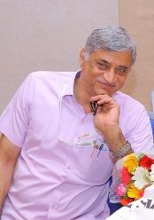
Let's Learn the art of Acting
Acting Classes
by Mohan Krishnan
Wednesday, 22nd June, 5:00 PM
Register - https://bit.ly/st_soh

